Slide 1
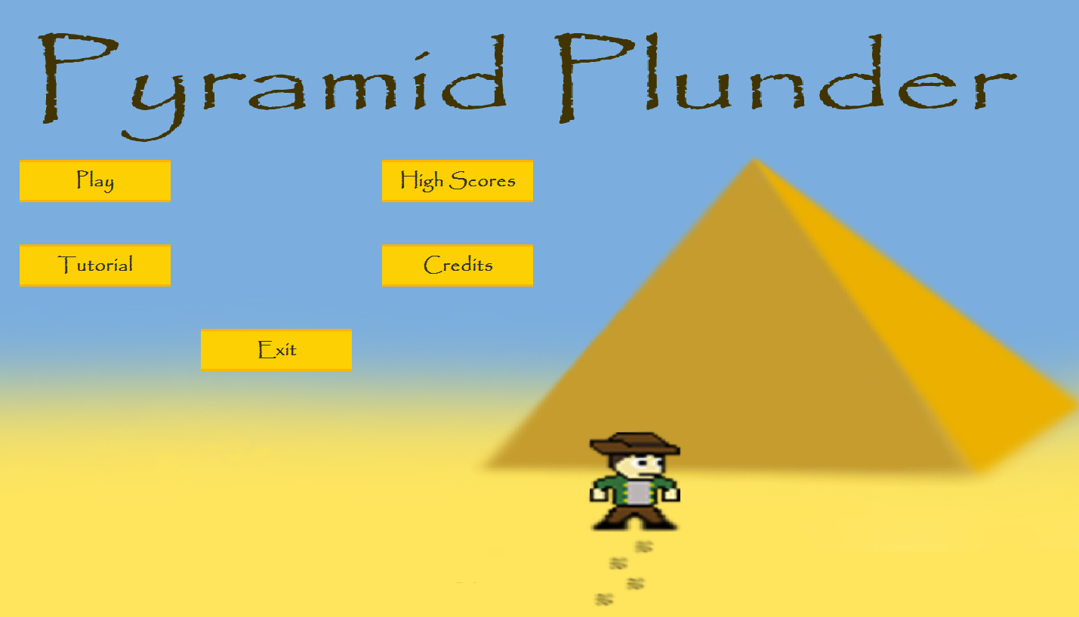
Pyramid Plunder
BitBlit Interactive Project Wayback
By The Techs

Slide 2
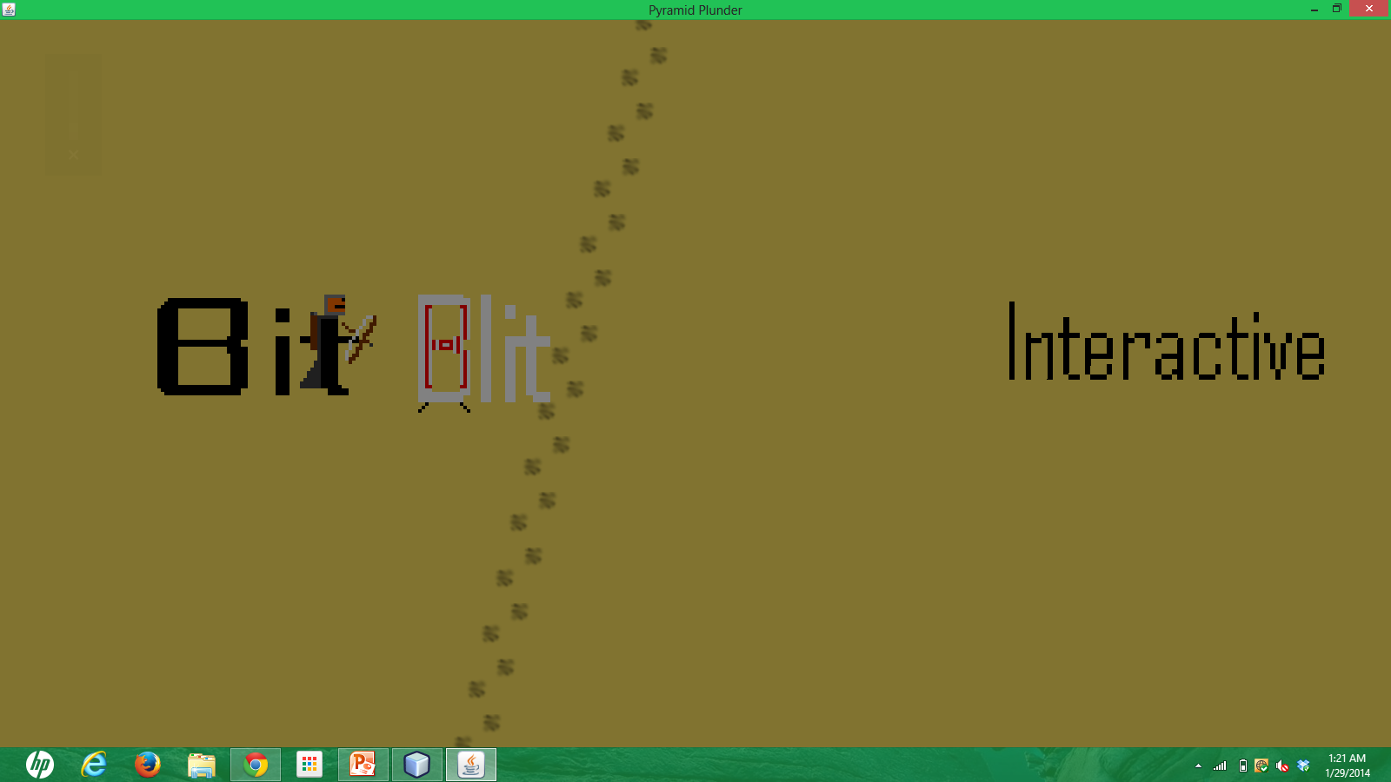
Background
BitBlit Interactive Austin, TX
Contracted Game Project: 8-Bit Style, Platform
Retro Inspired ‘Project Wayback’

Slide 3
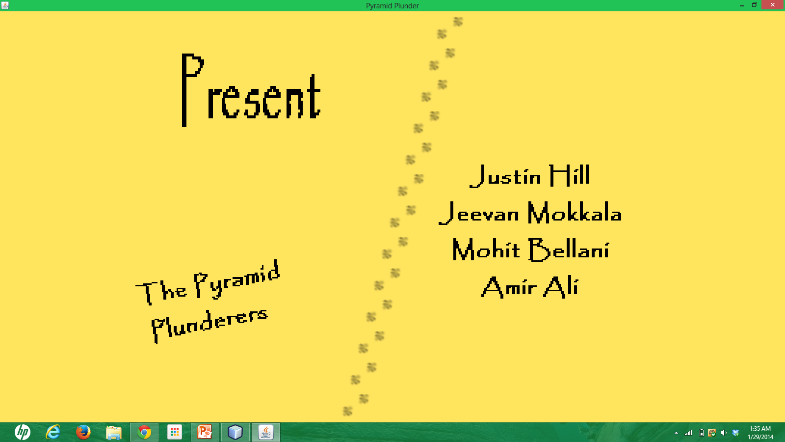
Team
Design and Organizational Manager
Chief Programmer
Graphics Designer
Documentation and Testing Manager

Slide 4
Design and Organizational Manager

Slide 5
Chief Programmer

Slide 6
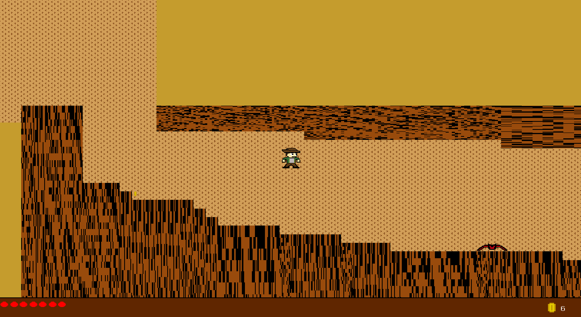
Graphics Designer

Slide 7
Documentation and Testing Manager

Slide 8
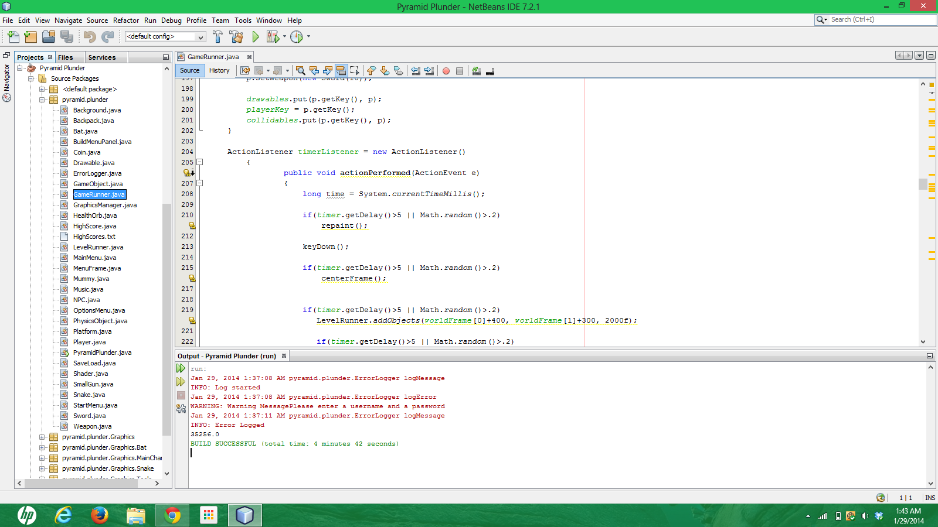
Design and developmental process

Slide 9
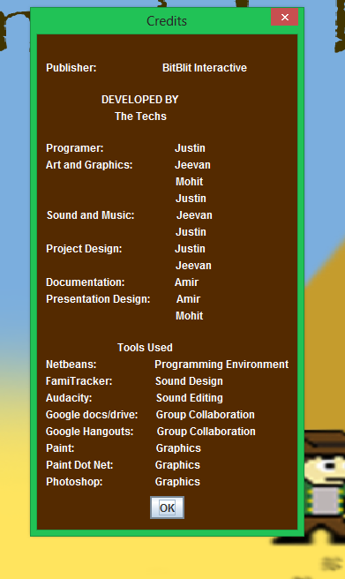
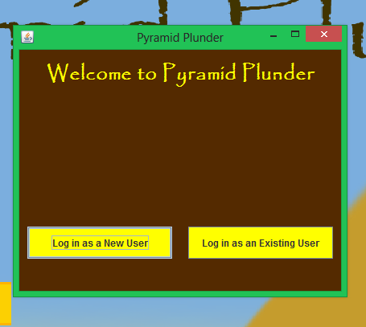
Additional features 1

Slide 10
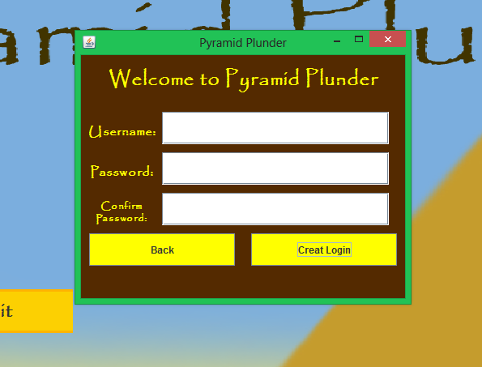
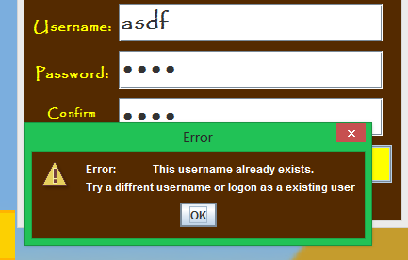
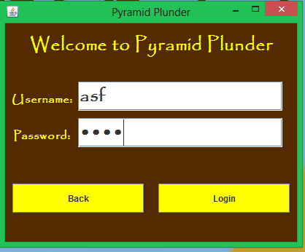
Additional features 2

Slide 11
Waterfall diagram

Slide 12
Innovative technology
Google Drive – To share code, graphics, music
Gimp 2
FamiTracker
Net Beans 7.4

Slide 13
Use/development of media elements
Graphics
Video
Audio

Slide 14
Testing
Team
Peers
Family
User Manual
Revisions

Slide 15
To do list
Using GOOGLE DRIVE as a communication and task manager.
The way we chose this topic.
How we made sure it was what consumers demanded.
How we established this topic.
Our future plans for this project.
How we might have changed this project.
How long we were given to finish and start this topic.
The enormous amount of behind-the-scenes work that went towards the success of this project.
Object Oriented Java programming.

